Slide 1
Requirements and constraints lightning talk
By sdmay22-30

Slide 2
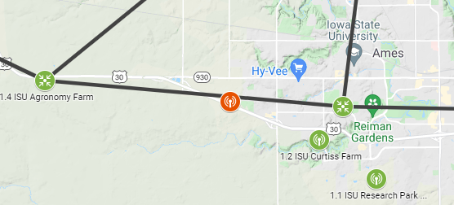
Requirements
Deploy Agriculture and Rural (ARA) base station equipment.
Setting up SDR and base stations at select ISU locations
Deploy ARA user equipment throughout the city of Ames and ISU research and teaching farms.
Devices that will use the 5G system that we setup
Perform measurements of network reliability and speeds.
Experiment with 5G-and-beyond solutions
Applications of 5G
Look at different frequency ranges, distances, and transfer speeds

Slide 3
Constraints
Resources are provided by the ARA research team such as wireless platforms and software defined radios.
Many different wireless platforms for testing a wide spectrum of frequencies over large distances.
Using the ARA SDR platforms to provide a network stack to the ARA research community.
Sub 7.2 GHz platforms from 470MHz to 806MHz
mmWave platforms from 24.25-29.5 GHz with 500MHz real-time bandwidth

Slide 4
Engineering Standards
IEEE 802: 5G standards will be referenced to conform code modifications to open-source software
Use of industry-accepted hardware standards for software defined radios (SDRs) and antennas to achieve the listed network spec constraints.
IEEE 1914.1 standard for Fronthaul Transport Networks (FTNs) will be referenced when defining what type of user-station network is being set up

Slide 5
References
https://futurenetworks.ieee.org/tech-focus/june-2017/standards-for-5g-and-beyond
https://arawireless.org/equipment/
https://arawireless.org/deployment/
https://arawireless.org/research/

